Slide 1
Weevil detection
Using Python, OpenCV and Tensorflow Lite on a Raspberry Pi

Slide 2
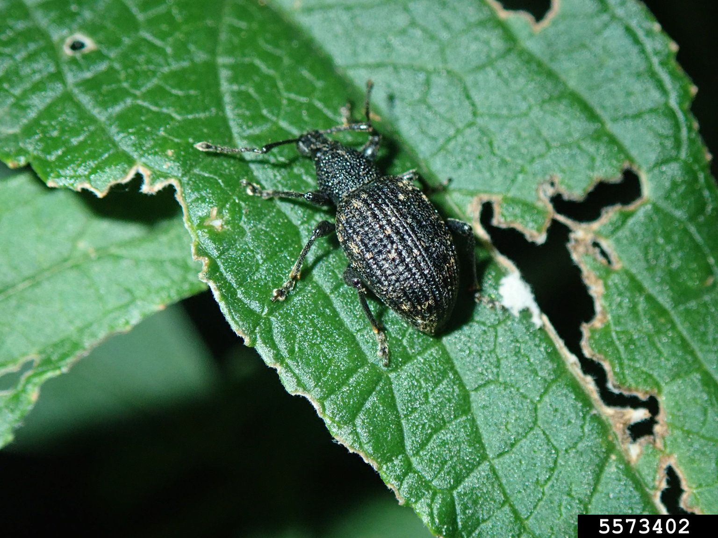
Concept
Weevils are a pest in ornamental plants and crops like strawberries.
Weevils like to hide in dark places during the daytime.
Make a ‘trap’ like an upturned plant pot with a camera and flash in the top looking down. The weevils can come and go freely.
Automatically and remotely identify the presence of weevils and report to the user.

Slide 3
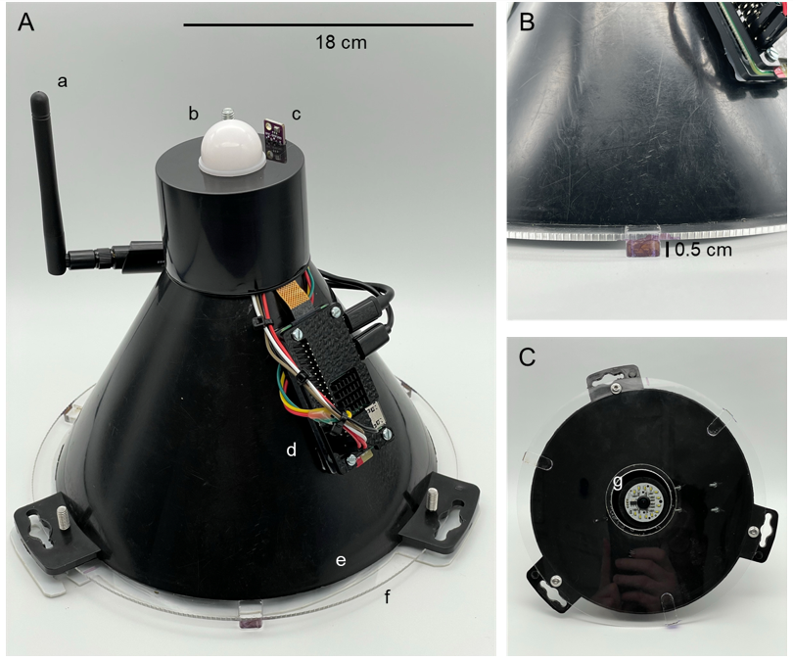
(A) External overview with (a) Wi-Fi antenna, (b) BH1750FVI lux sensor, (c) BME280 temperature / humidity sensor, (d) Raspberry Pi Zero 2W, (e) clear acrylic and (f) entry location, (B) close-up of entry location and 0.5 cm stand-offs and (C) internal view of the (g) LED ring light and camera.
Photos: Joe Roberts

Slide 4
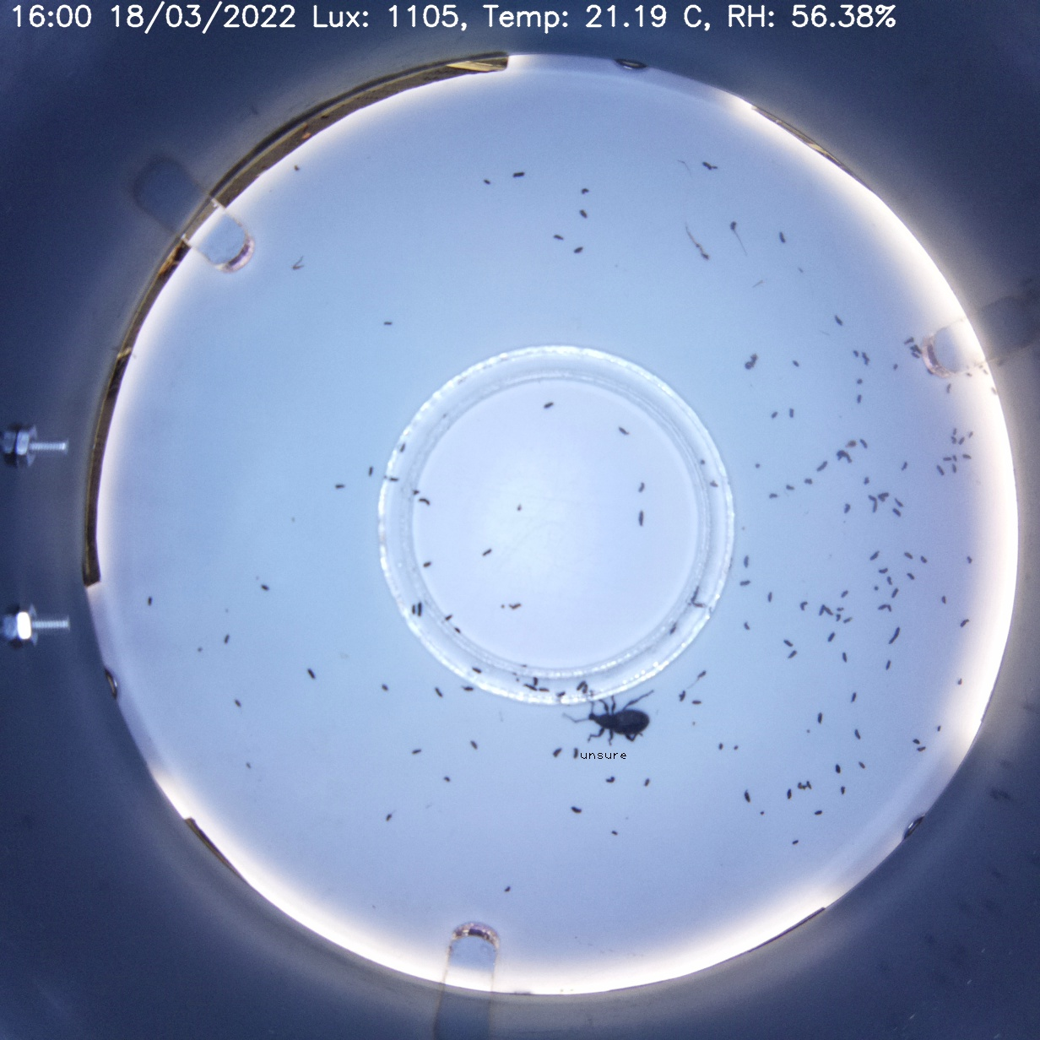
Trap view
Other sensors (and clock) connected via I2C bus

Slide 5
Challenges – and solutions
Other insects may come into the trap – use AI to classify insects.
Weevils like to huddle together making identification difficult – capture individuals before they enter the huddle with regular snapshots, and isolate them as ‘regions of interest (ROI)’ using conventional image processing techniques.
The processor connected to the camera is low-power (in terms of processing power and power consumption), and low cost – use conventional image processing techniques to further refine ROIs into uniform ‘passport style’ images which can be classified by AI instead of using object detection. This is much less demanding.

Slide 6
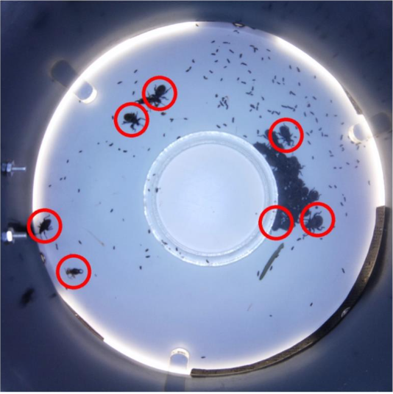
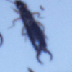
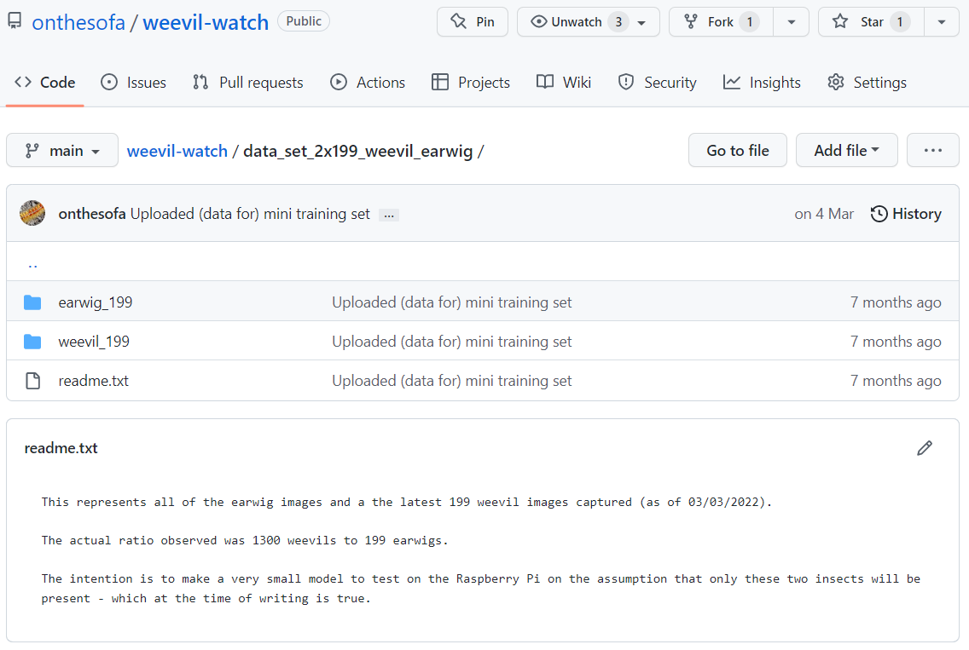
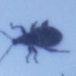
Training stage – passport images are collected to build a training set
Everything is available on GitHub!
Camera resolution is 1232 x 1232 pixels
Anything that moved in the last 10 minutes and met the criteria of a single insect was uploaded for manual sorting into a training dataset. Each image is 100 x 100 pixels.

Slide 7
Simplifying classification task using OpenCV
(pip install opencv-python)

Slide 8
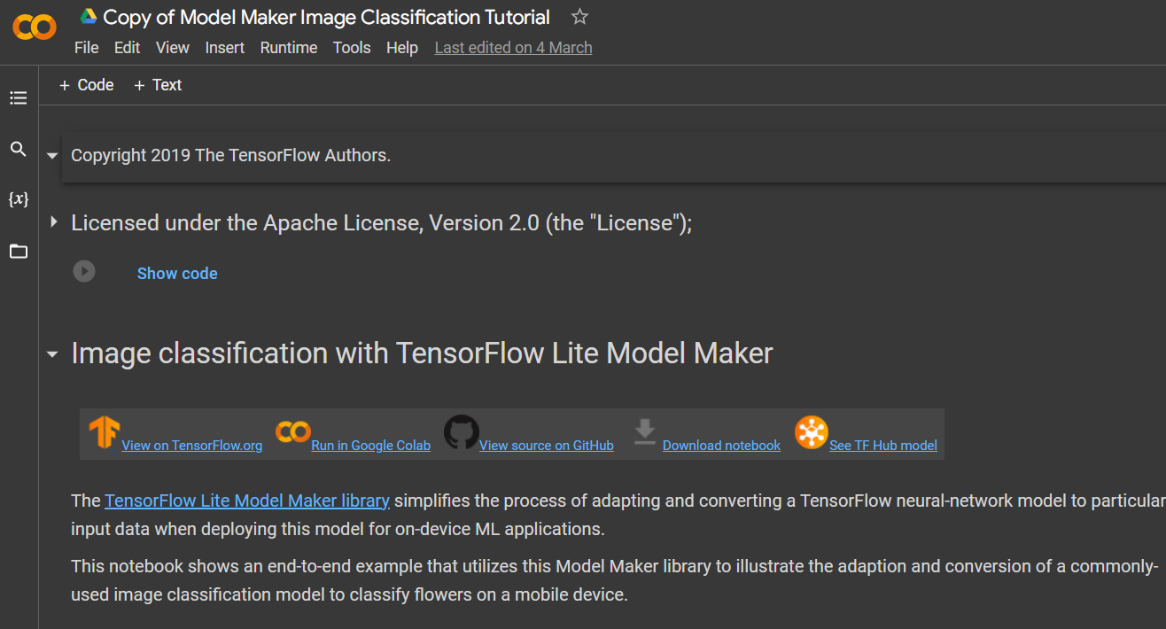
Training the model (on Google Colab)

Slide 9
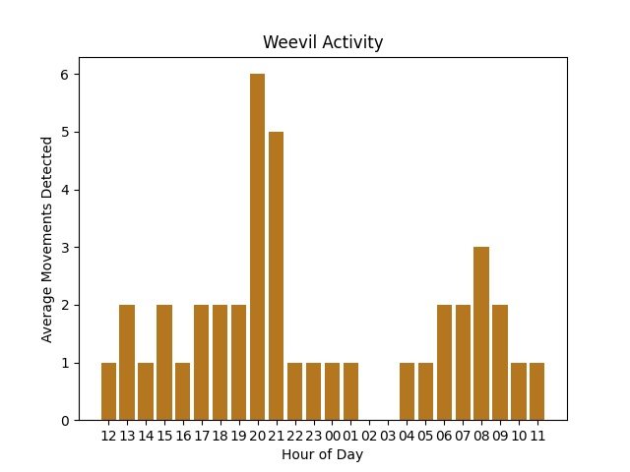
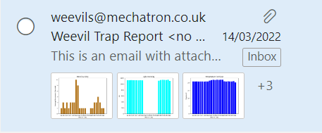
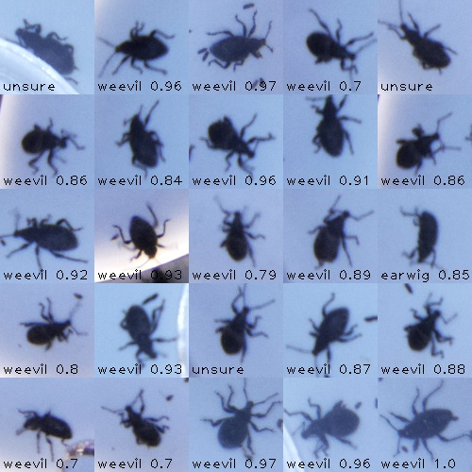
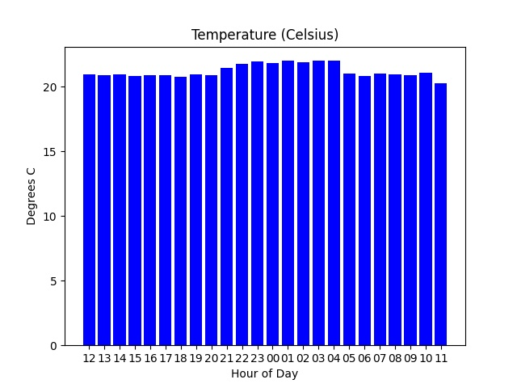
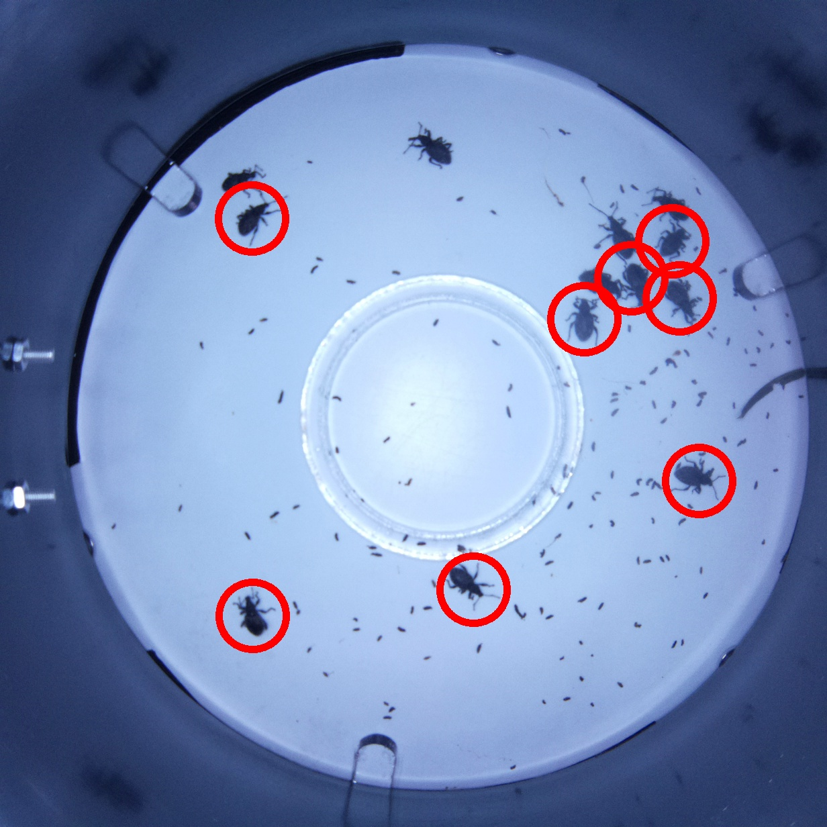
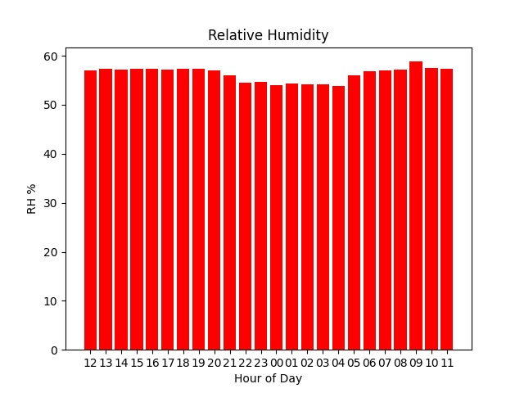
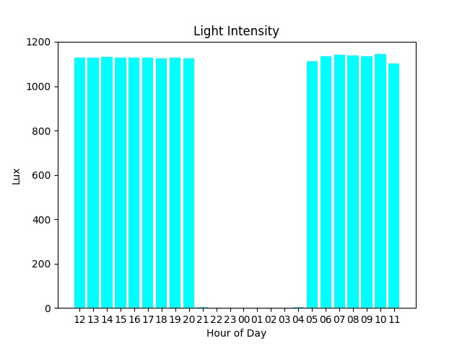
Reporting the results to the user

Slide 10
